Slide 1
Mutual informatiom
Royi Itzhak
Compobio course

Slide 2
The Big Picture
Probability
Model
Data
Estimation/learning
But how to specify a model?

Slide 3
Graphical Models
How to specify the model?
  What are the variables of interest?
  What are their ranges?
  How likely their combinations are?
You need to specify a joint probability distribution
  But in a compact way
    Exploit local structure in the domain
Today: we will cover some concepts that formalize the above statements

Slide 4
Probability Review
Events and Event spaces
Random variables
Joint probability distributions
  Marginalization, conditioning, chain rule, Bayes Rule, law of total probability, etc.
Structural properties
  Independence, conditional independence
Examples
Moments

Slide 5
Sample space and Events
Ω : Sample Space, result of an experiment
  If you toss a coin twice Ω = {ΗΗ,ΗΤ,ΤΗ,ΤΤ}
Event: a subset of Ω
  First toss is head = {HH,HT}
S: event space, a set of events:
  Closed under finite union and complements
    Entails other binary operation: union, diff, etc.
  Contains the empty event and Ω

Slide 6
Probability Measure
Defined over (Ω,S) s.t.
  P(α) >= 0 for all α in S
  P(Ω) = 1
  If α, β are disjoint, then
    P(α U β) = p(α) + p(β)
We can deduce other axioms from the above ones
      Ex: P(α U β) for non-disjoint event

Slide 7
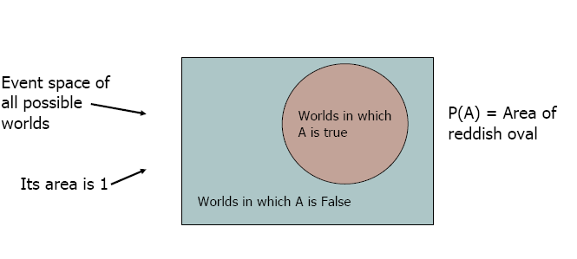
Visualization
We can go on and define conditional probability, using the above visualization

Slide 8
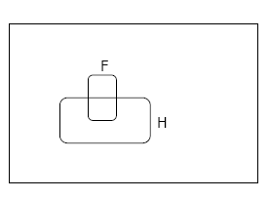
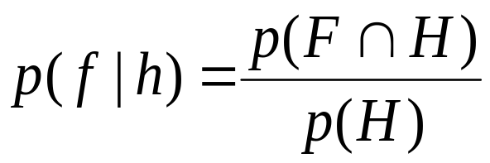
Conditional Probability
P(F|H) = Fraction of worlds in which H is true that also have F true

Slide 9
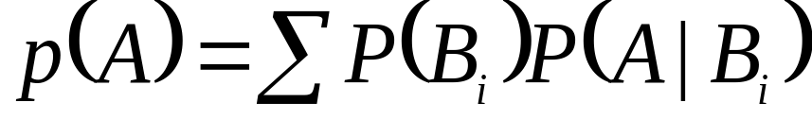
Rule of total probability
B₅
B₃
B₂
B₄
A
B₁
B₇
B₆

Slide 10
From Events to Random Variable
Concise way of specifying attributes of outcomes
Modeling students (Grade and Intelligence):
  Ω = all possible students
  What are events
    Grade_A = all students with grade A
    Grade_B = all students with grade A
    Intelligence_High = … with high intelligence
  We need “functions” that maps from Ω to an attribute space

Slide 11

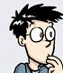
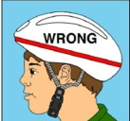

Random Variables
Ω
I:Intelligence
High
low
A
G:Grade
B
A+

Slide 12
Random Variables
Ω
I:Intelligence
High
low
A
G:Grade
B
A+
P(I = high) = P( {all students whose intelligence is high})

Slide 13
Probability Review
Events and Event spaces
Random variables
Joint probability distributions
  Marginalization, conditioning, chain rule, Bayes Rule, law of total probability, etc.
Structural properties
  Independence, conditional independence
Examples
Moments

Slide 14
Joint Probability Distribution
Random variables encodes attributes
Not all possible combination of attributes are equally likely
  Joint probability distributions quantify this
P( X= x, Y= y) = P(x, y)
  How probable is it to observe these two attributes together?
  How can we manipulate Joint probability distributions?

Slide 15
Chain Rule
Always true
  P(x,y,z) = p(x) p(y|x) p(z|x, y)
      = p(z) p(y|z) p(x|y, z)
      =…

Slide 16
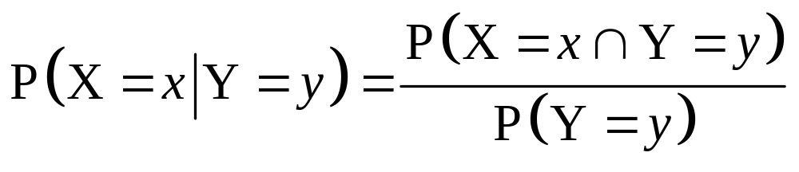
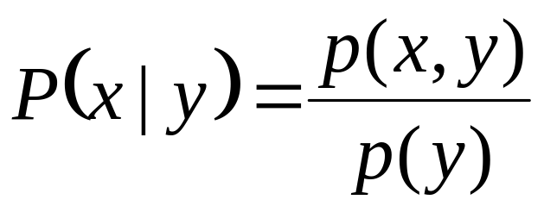
Conditional Probability
events
But we will always write it this way:

Slide 17
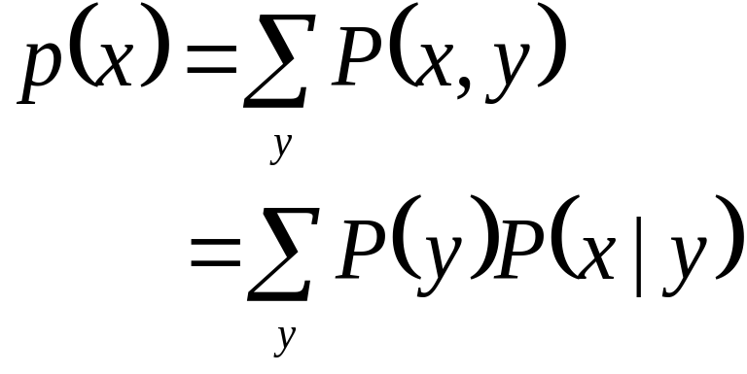
Marginalization
We know p(X,Y), what is P(X=x)?
We can use the low of total probability, why?
B₅
B₃
B₂
B₄
A
B₇
B₆
B₁

Slide 18
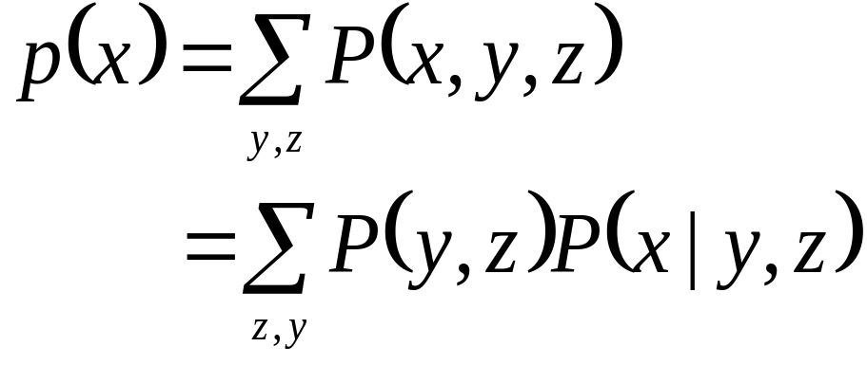
Marginalization Cont.
Another example

Slide 19
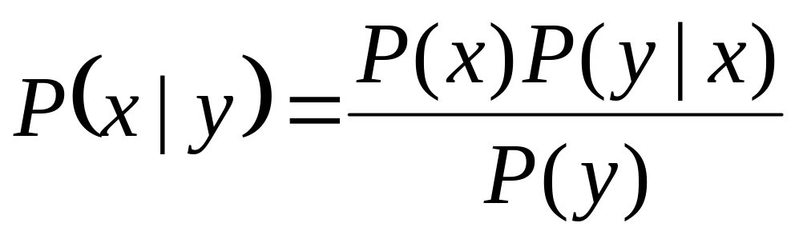
Bayes Rule
We know that P(smart) = .7
  If we also know that the students grade is A+, then how this affects our belief about his intelligence?
  Where this comes from?

Slide 20
Probability Review
Events and Event spaces
Random variables
Joint probability distributions
  Marginalization, conditioning, chain rule, Bayes Rule, law of total probability, etc.
Structural properties
  Independence, conditional independence
Examples
Moments

Slide 21
Independence
X is independent of Y means that knowing Y does not change our belief about X.
  P(X|Y=y) = P(X)
  P(X=x, Y=y) = P(X=x) P(Y=y)
    Why this is true?
  The above should hold for all x, y
  It is symmetric and written as X ⊥ Y

Slide 22
CI: Conditional Independence
RV are rarely independent but we can still leverage local structural properties like CI.
X ⊥ Y | Z if once Z is observed, knowing the value of Y does not change our belief about X
  The following should hold for all x,y,z
  P(X=x | Z=z, Y=y) = P(X=x | Z=z)
  P(Y=y | Z=z, X=x) = P(Y=y | Z=z)
  P(X=x, Y=y | Z=z) = P(X=x| Z=z) P(Y=y| Z=z)
We call these factors : very useful concept !!

Slide 23
Probability Review
Events and Event spaces
Random variables
Joint probability distributions
  Marginalization, conditioning, chain rule, Bayes Rule, law of total probability, etc.
Structural properties
  Independence, conditional independence
Examples
Moments

Slide 24
We know that the prevalence of a particular disease is 1/1000 in the general population.
A test for this ailment has a false positive rate of 5%, that is, 5% of the time the test will erroneously indicate that the disease is present when in fact it is not.
We are also told that 98% of the people with the disease will in fact test positive.
What is the probability that a person that has tested positive does in fact have the disease?
Disease Problem

Slide 25

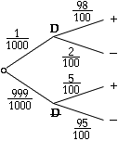
First let's model this: we will use D to denote presence of the disease, DN to denote it is not present, we will use + for positive tests and-for negative tests. Our problem then translates as:
P(D) =
P(+|DN) = 5/100
P(+|D) = 98/100
We want to find P(D|+)

Slide 26
A cab was involved in a hit and run accident at night. Two cab companies, the Green and the Blue, operate in the city. You are given the following data:
85% of the cabs in the city are Green
15% are Blue. a witness identified the cab as Blue.
The court tested the reliability of the witness under the same circumstances that existed on the night of the accident and concluded that the witness correctly identified each one of the two colors 80% of the time and failed 20% of the time.What is the probability that the cab involved in the accident was Blue rather than Green?
Car Accidents Problem

Slide 27
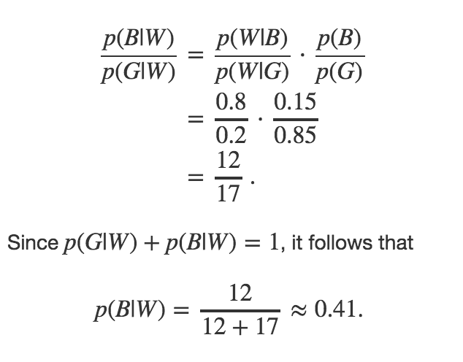
Let G be the event of the delinquent being Green. Let B be the event of the delinquent being Blue. Finally, let W be the witness' report.

Slide 28
There are 30 people in a room ... what is the chance that any two of them celebrate their birthday on the same day? Assume 365 days in a year
Birthday Problem

Slide 29
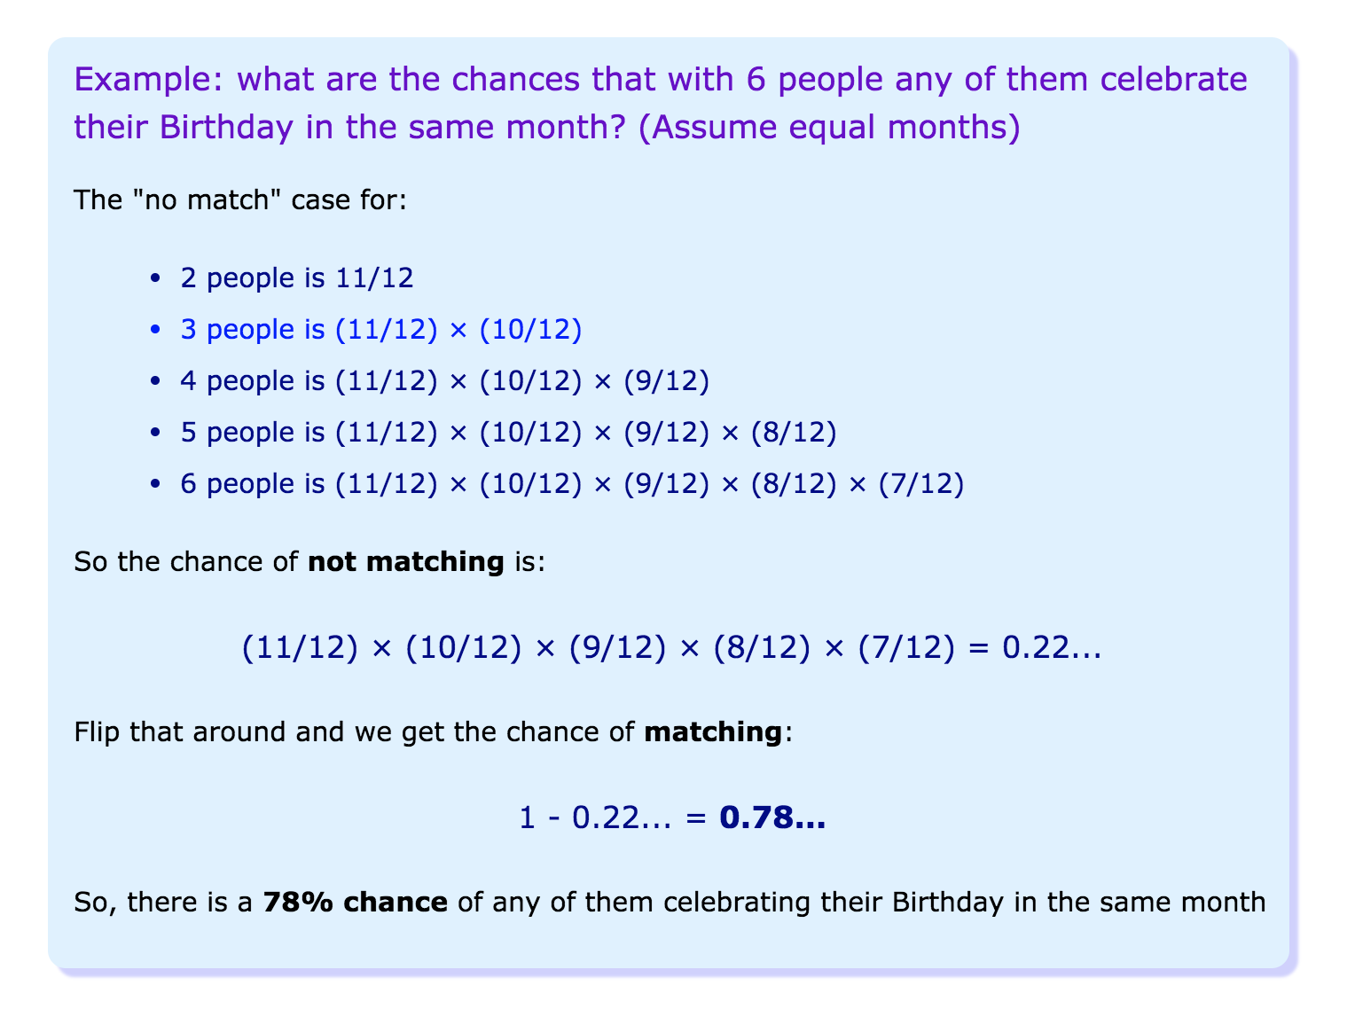

Slide 30
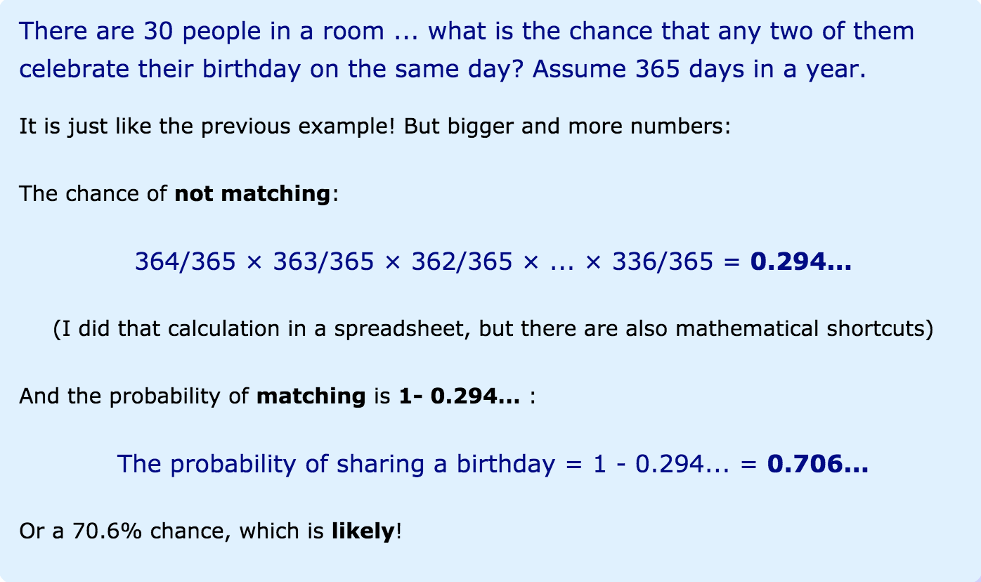

Slide 31
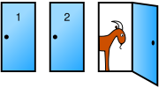
Monty Hall Problem
You're given the choice of three doors: Behind one door is a car; behind the others, goats.
You pick a door, say No. 1
The host, who knows what's behind the doors, opens another door, say No. 3, which has a goat.
Do you want to pick door No. 2 instead?

Slide 32

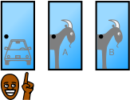

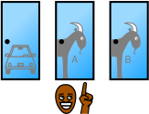
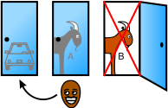
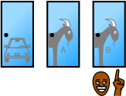
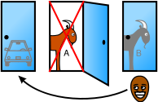
 |  | Host must reveal Goat B
 |  | Host must reveal Goat A
Host reveals Goat A or Host reveals Goat B

Slide 33
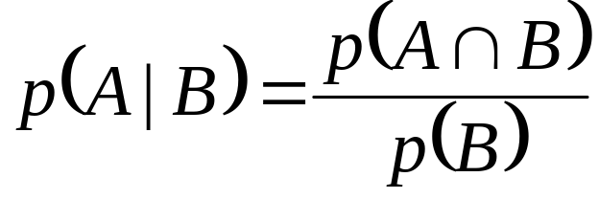
We can determine these probabilities using the rule
In words: The probability of event A given event B is the probability of both A and B divided by the probability of B.

Slide 34
In the following argument:
Assume that:
  we originally chose door #1.
  Monty opened door #2.
Notation
  Let “#1” denote the event that the prize is behind door #1, and similarly for doors #2 and #3.
  Let “opened #2” denote the event that Monty has opened door #2.
Our aim is to compute p(#1 | opened #2) and p(#3 | opened #2).

Slide 35
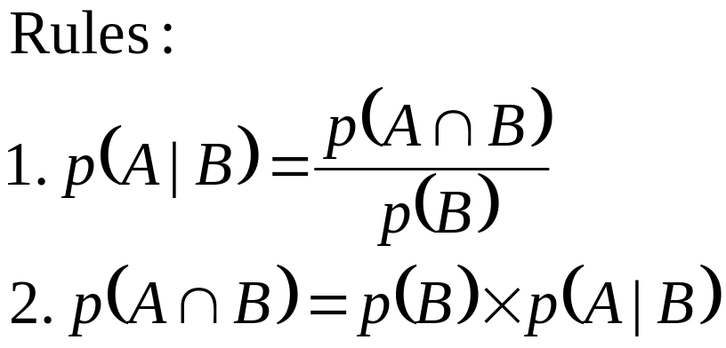
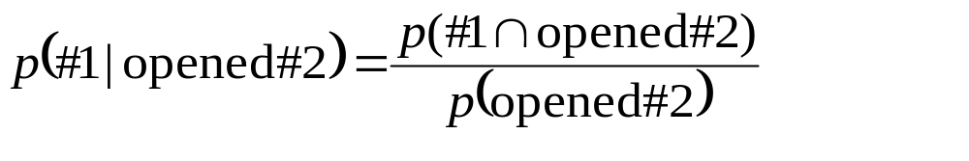
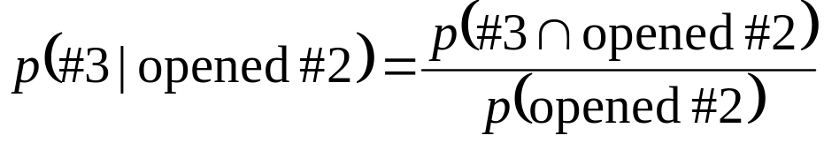
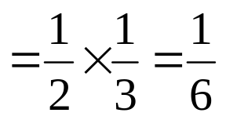
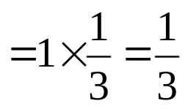
(By rule 2.)
(If the prize is behind door #1, Monty can open either #2 or #3.)
(By rule 2.)
(If the prize is behind door #3, Monty must open door #2.)

Slide 36
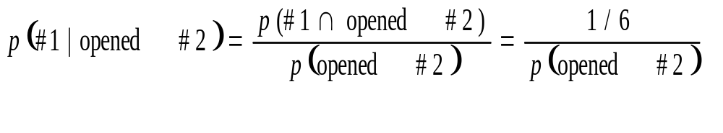
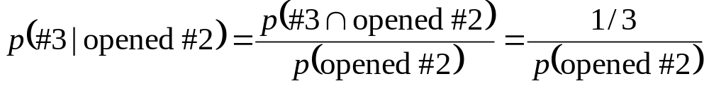
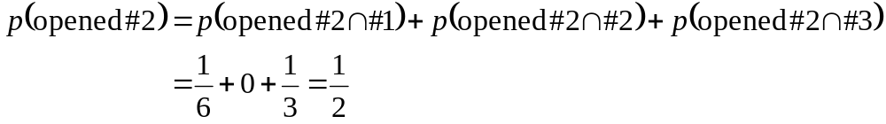
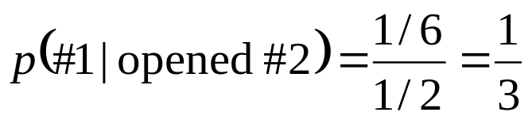
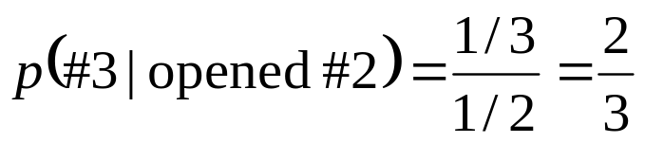
So:
and

Slide 37
In basket ball game for a player to win a game
challenge 1) 2 out of 3 throws should be basket
challenge 2) 5 out of 8 throws should be basket
which challenge should the player choose so that he might have better chance of winning the game?

Slide 38
C(3,2)*p^2*(1-p)^1+C(3,3)*p^3*(1-p)^0
C(8,5)*p^5*(1-p)^3 + C(8,6)*p^6*(1-p)^2 +
C(8,7)*p^7*(1-p)^1 + C(8,8)*p^8

Slide 39
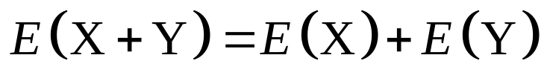
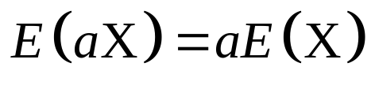
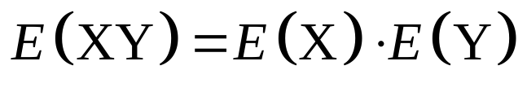
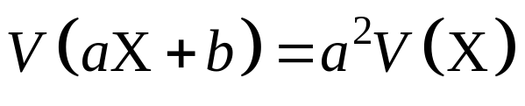
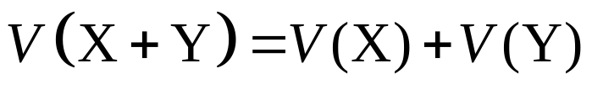
Properties of Moments
Mean
  If X and Y are independent,
Variance
  If X and Y are independent,

Slide 40
The Big Picture
Probability
Model
Data
Estimation/learning

Slide 41
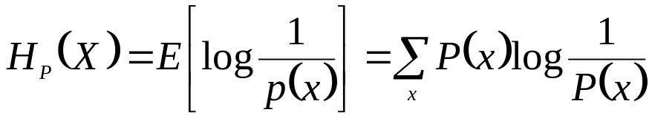
Information Theory
P(X) encodes our uncertainty about X
  Some variables are more uncertain that others
  How can we quantify this intuition?
    Entropy: average number of bits required to encode X
P(X)
P(Y)
X
Y

Slide 42
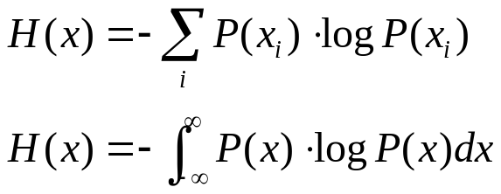
Entropy
מדד למידת אי הוודאות של מ"מ אקראי בהתפלגות מסוימת
במדעי המחשב אנטרופיה היא מדד למספר הביטים הדרושים להעברת מידע
לדוגמא נתון מטבע הוגן מהי מידת האנטרופיה של התוצאות
אם המטבע לא הוגן ו10% פעמים יוצא עץ
אם המטבע לא הוגן ו1% פעמים יוצא עץ

Slide 43
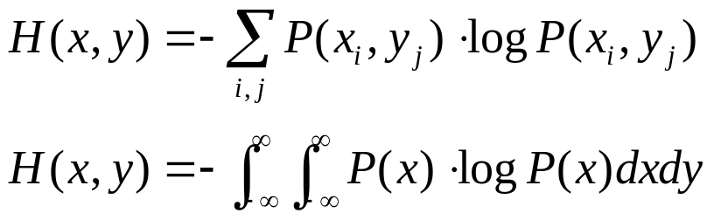
Mutual Entropy
מה האנטרופיה של שני הטלות של מטבע הוגן ,באופן פשוט 0.25 עבור כל צירוף , עץ ועץ ,עץ ופלי , פלי עץ,פלי פלי. לכן האנטרופיה תהיה -4*0.25*-2=2.
אם המטבע לא הוגן והסיכוי להגריל עץ הוא 0.9
אזי ההסתברות המשותפת היא
והאנטרופיה המשותפת תהיה
-0.81*log2(0.81)-2*0.09*log2(0.09)-0.01*log2(0.01)=0.936
 | T | H
T | 0.9*0.9=0.81 | 0.9*0.1=0.09
H | 0.9*0.1=0.09 | 0.1*0.1=0.01

Slide 44
Mutual information
אינפורמציה משותפת של שני משתנים x,y היא מדד להורדת אי הוודאות של כל משתנה בנפרד בהנתן המשתנה השני
I(x,y)=H(x)+H(y)-H(x,y)

Slide 45
Mutual information of 3 states
 | 1 | 2 | 3 | 4 | 5 | 6 | 7 | 8 | 9 | 10 | 11 | 12 | 13 | 14 | 15
1 | 4 | 3 | 3 | 3 | 5 | 5 | 6 | 4 | 6 | 5 | 4 | 5 | 5 | 4 | 1
2 | 4 | 5 | 5 | 5 | 3 | 4 | 3 | 5 | 5 | 2 | 3 | 3 | 1 | 1 | 1
3 | 1 | 3 | 5 | 4 | 6 | 2 | 1 | 2 | 1 | 1 | 1 | 2 | 1 | 5 | 2
4 | 1 | 1 | 1 | 1 | 2 | 1 | 3 | 4 | 3 | 3 | 3 | 6 | 5 | 5 | 4
5 | 2 | 1 | 5 | 2 | 3 | 1 | 5 | 1 | 1 | 5 | 3 | 4 | 3 | 1 | 3
6 | 5 | 2 | 3 | 5 | 2 | 4 | 3 | 1 | 5 | 1 | 5 | 3 | 3 | 2 | 3
7 | 5 | 3 | 4 | 5 | 5 | 3 | 2 | 3 | 5 | 3 | 5 | 4 | 5 | 2 | 1
8 | 1 | 2 | 2 | 2 | 1 | 4 | 2 | 3 | 3 | 4 | 6 | 4 | 5 | 5 | 4
9 | 4 | 4 | 1 | 2 | 3 | 1 | 2 | 2 | 4 | 1 | 4 | 5 | 3 | 1 | 3
10 | 2 | 3 | 2 | 1 | 2 | 3 | 3 | 2 | 3 | 5 | 3 | 3 | 3 | 2 | 5

Slide 46
example
for example feature 1
H(y)=-3*0.333*log(0.333)=1.58
H(x)=[1/15*log(1/15)+0+0.2*log(0.2)+0.2*log(0.2)+0.333*log(0.333)+0.2*log(0.2)]*-1=2.1819
H(x,y)=
-[5*1/15*log(1/15)+3*log(2/15)+0.2*log(0.2)]=2.922
I(x,y)=1.585+2.1819-2.922=0.844
0 | 0 | 1/15
0 | 0 | 0
0.2 | 0 | 0
1/15 | 1/15 | 2/15
1/15 | 2/15 | 2/15
0 | 1/15 | 0

Slide 47
example
for example feature 4
H(y)=-3*0.333*log(0.333)=1.585
H(x)=[0.333*log(0.333)+1/15*log(1/15)+4/15*log(4/15)+2/15*log(2/15)+2/15*log(2/15)+1/15*log(1/15)]*-1=2.339
H(x,y)=
-[6*1/15*log(1/15)+2/15*log(2/15)+0.2*log(0.2)+0.4*log(0.4)]=2.943
I(x,y)=1.585+2.339-2.942=0.982
4/15 | 1/15 | 0
1/15 | 0 | 0
0 | 0.2 | 1/15
0 | 1/15 | 1/15
0 | 0 | 2/15
0 | 0 | 1/15

Slide 48
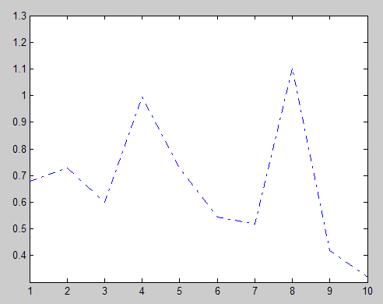
Ixy=Hx+Hy-Hxy
i | H(x) | H(y) | H(x,y) | I(x,y)=H(x)+H(y)-H(x,y)
1 | 2.149255 | 1.5848 | 3.056565 | 0.67751
2 | 2.149255 | 1.5848 | 3.006239 | 0.727836
3 | 2.206239 | 1.5848 | 3.189898 | 0.60116
4 | 2.332915 | 1.5848 | 2.923231 | 0.994503
5 | 2.149255 | 1.5848 | 3.006239 | 0.727836
6 | 2.149255 | 1.5848 | 3.189898 | 0.544177
7 | 2.072906 | 1.5848 | 3.139572 | 0.518153
8 | 2.440224 | 1.5848 | 2.923231 | 1.101812
9 | 2.206239 | 1.5848 | 3.373557 | 0.417501
10 | 1.689482 | 1.5848 | 2.955913 | 0.318389

Slide 49
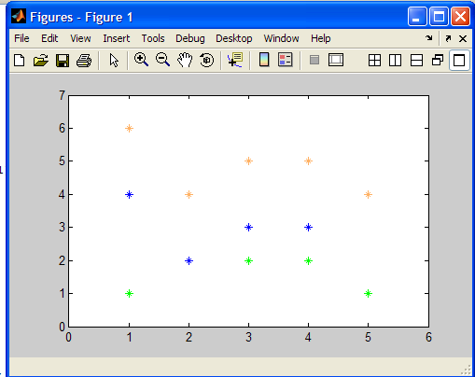
Mutual informaion feature 8
The real values of the data in the 8th row

Slide 50

Continues mutual information- Uniform decoder
Blank condition Vs two visual stimuli of full field two orientations one is horizontal and the other vertical orientation

Slide 51
Sorry , teaching sucks
function Ixy=MutualInformation(X,Y);
u=unique(Y);
y=zeros(1,length(u));
for i=1:numel(u)
y(i)=numel(find(Y==u(i)));
end
y=y(y>0);
y=y./sum(y);
Hy=sum(-y.*log10(y));
[m n]=size(X);
Hx=zeros(1,m);
Hxy=zeros(m,length(u));
for i=1:m
vect=X(i,:);
dxMax=max(vect);
dxMin=min(vect);
x=linspace(dxMin,dxMax,10);
[a b]=hist(vect,x);
a=a(a>0);
a=a./sum(a);
Hx(i)=sum(-a.*log10(a));
for j=1:length(u)
temp_k=X(i,find(Y==u(j)));
x=linspace(dxMin,dxMax,10);
[a1 b1]=hist(temp_k,x);
a1=a1(a1>0);
a1=a1./sum(a);
Hxy(i,j)=sum(-a1.*log10(a1));
end
end
Ixy=Hx+Hy-sum(Hxy,2)';

Slide 52
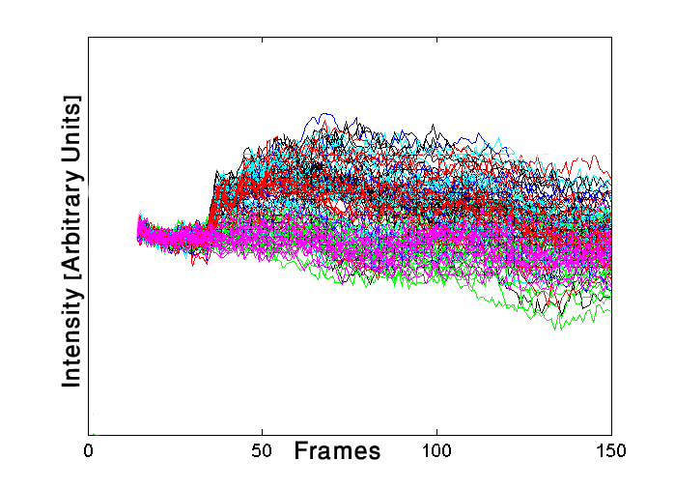
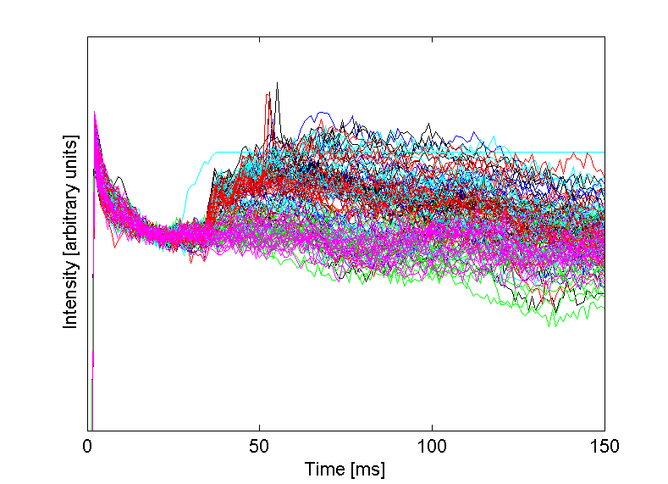
Each curve is a different trial. The visual stimulus in each trial is denoted by a different color. the variance among trials is too large to allow the determination of the visual condition
using a single trial

Slide 53
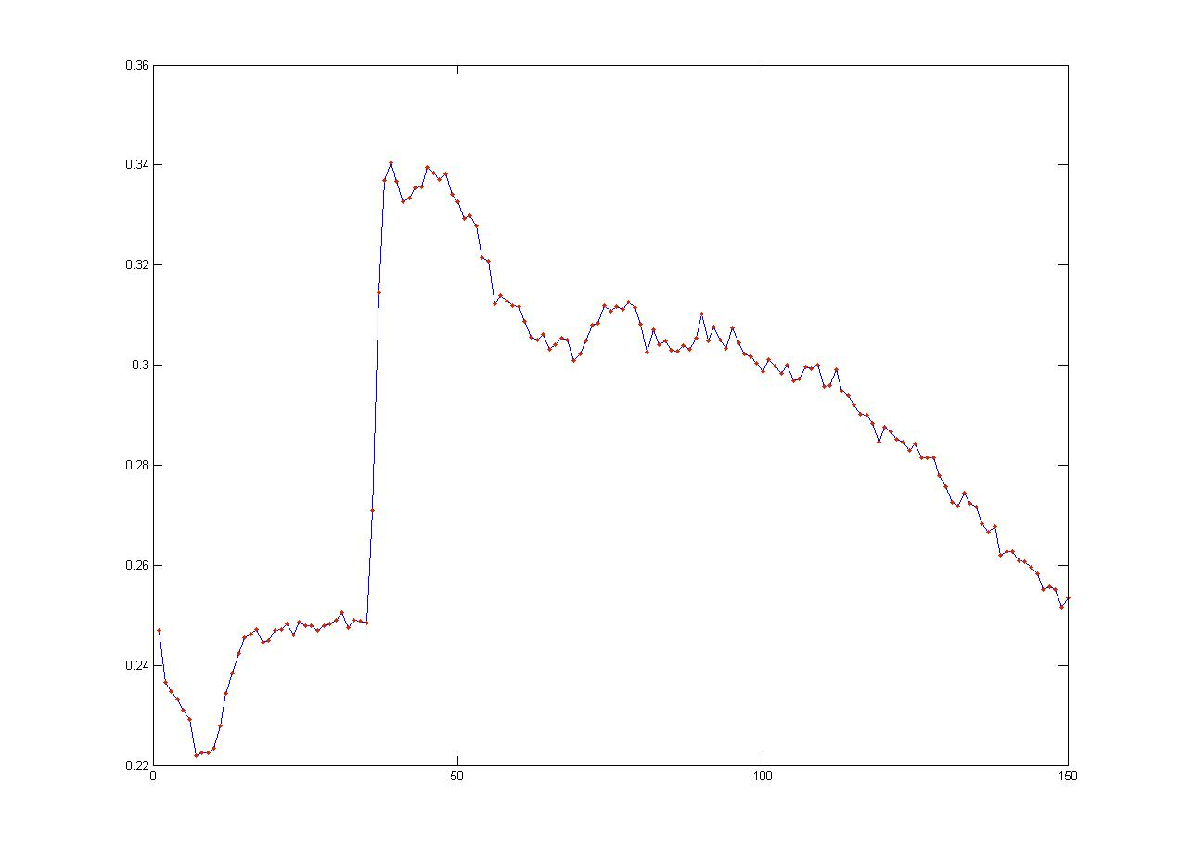
Average mutual information
The most informative time interval is between frames 40-44
that are120-160 ms after visual stimulus onset.
For each time frame, the mutual information between each pixel and the visual conditions was computed and then averaged across all pixels in the imaged area. X-denote the pixels , Y-denote the 3 different conditions

Slide 54
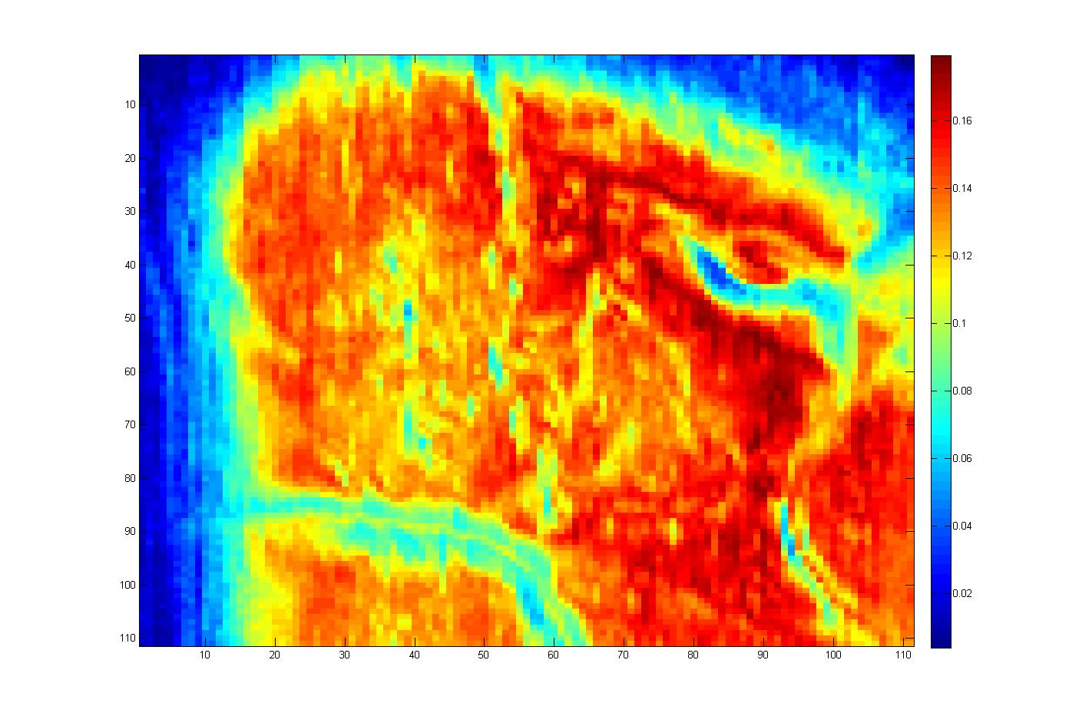
Spatial map of mutual information
The map presents the mutual information content in areas V1 and V2; Red stands for high and blue for low mutual information values.

Slide 55
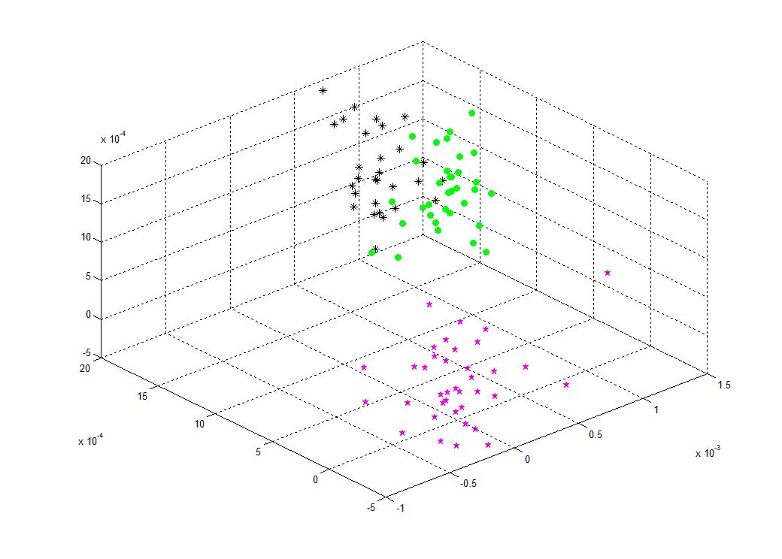
Clustering
3 kind of orientations using the average of the signal value across frames 37-40.Represnted only by three highest mutual information pixels that not localized on the edges of blood vessels. Pink-blank , green – horizontal , black - vertical

